Slide 1
Identifying Rideshare Targets
In Manhattan
Andrew Wu, Bryan Ross, Kaitlin Chaung

Slide 2
Problem
Decrease in NYC ridership, due to the pandemic
Project Goal
Identify neighborhoods of opportunity to target in Manhattan
Notes:
Potential client is a ride-share company that has experienced downturn in business as a result of the pandemic. They’re looking to maximize profits as NYC lockdown is lifted, as well as potentially expand their customer base.

Slide 3
01 Aggregate
Data to inform initial neighborhood
recommendations
Notes:
Used MTA data from March-June 2019-2020. First factor looked at: percent decrease.
Largest percent decreases since these presumably were the hardest hit areas as a result of the pandemic rather than a fault of the area itself, and that traffic would pick back up as conditions improved. But also that past MTA riders may be more inclined to use ride-share services for social distancing.
To get counts, used MTA 2018 data (find highest daily ridership station, divided by # of turnstiles in station, and intervals per day, 10x that), 100x previous entry, negative values. Filled with station weekly median.

Slide 4
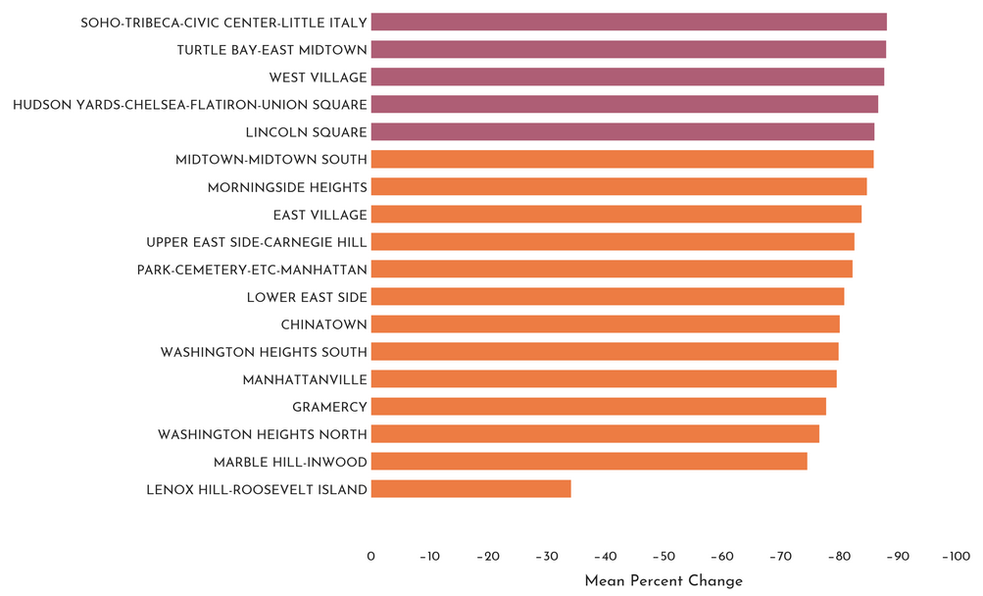
Mean Percent Ridership Change (2019-2020)
Notes:
Mean daily percent ridership changes between 2019-2020. Initially examined all neighborhood percent changes.
We wanted to filter this down to the top 5.

Slide 5
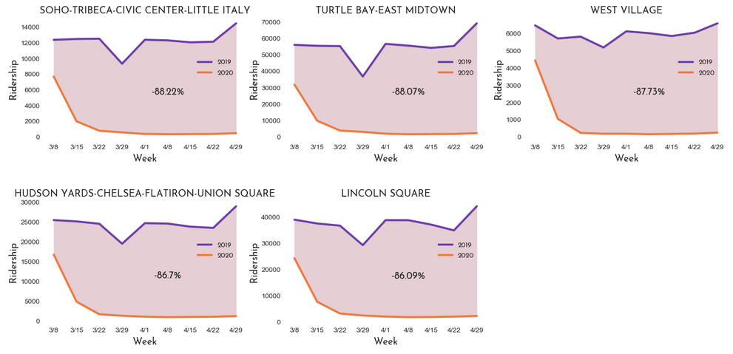
Average Daily Ridership (Top 5 Decreases)
Notes:
Purple line 2019
Orange line 2020
Mean % change across this timeframe is the number located in the fill

Slide 6
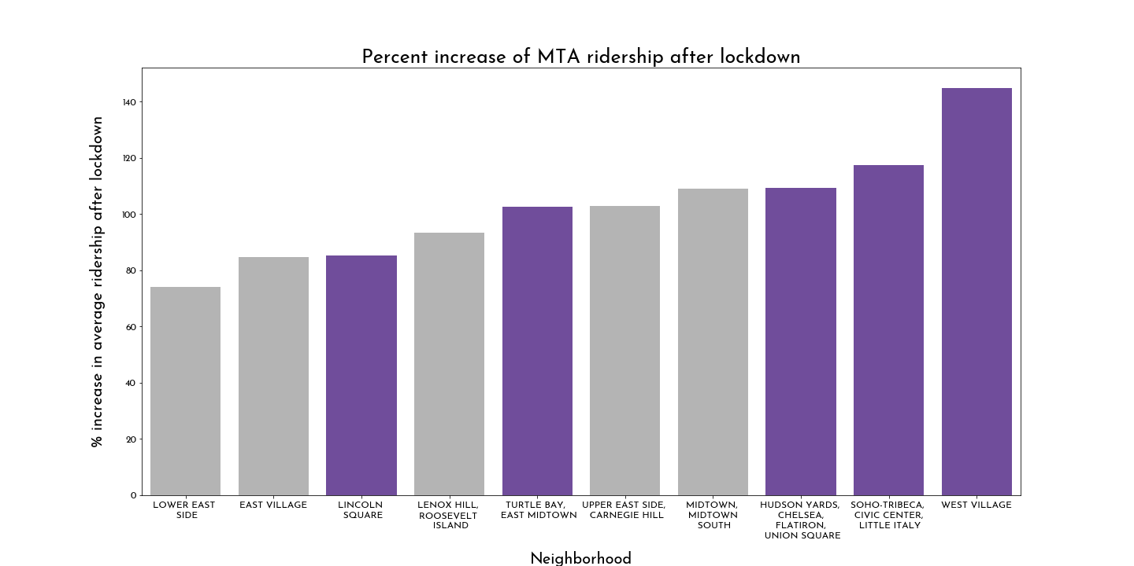
TEMPLATE
Notes:
HUDSON YARDS-CHELSEA-FLATIRON-UNION SQUARE, MIDTOWN-MIDTOWN SOUTH, SOHO-TRIBECA-CIVIC CENTER-LITTLE ITALY,
UPPER EAST SIDE-CARNEGIE HILL, WEST VILLAGE

Slide 7
02 Determine
If neighborhoods fit target demographic
Notes:
It is also important for us to validate that these 5 neighborhoods
have a demographic profile that is similar to that of a rideshare user.

Slide 8
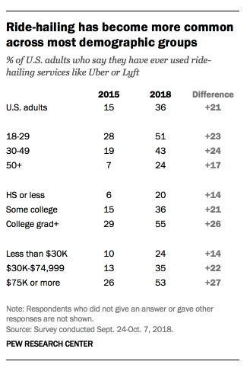
Defining Target Demographic
Notes:
From this study by PEW research,
we’ve developed a preliminary profile for our target demographic,
as defined by the factors of
Age, education, and income
Source: https://www.pewresearch.org/fact-tank/2019/01/04/more-americans-are-using-ride-hailing-apps/

Slide 9
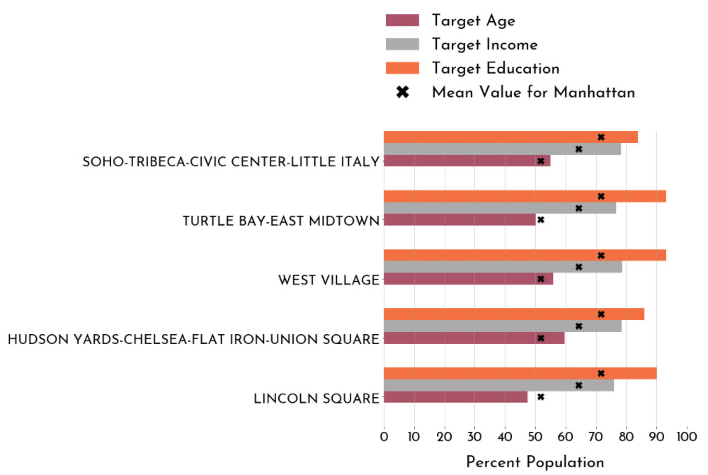
Demographic Profile of Target Neighborhoods
Notes:
-To determine if these 5 neighborhoods fit our target demographic profile, we’ve visualized the percent populations for each of these three factors
- In this plot, the black x on each bar represents the mean value of that factor, for all of manhattan
-From here, you can see that all 5 neighborhoods have similar profiles per factor,
in which their percent population is either similar to the mean or exceeds it,
validating that these neighborhoods fit our target profile
Source: 2016 Census Data, ACS

Slide 10
03 REFINE
Which neighborhoods best represent target market
Notes:
From here, we conducted further analysis to determine which of THESE 5 neighborhoods represent prime targets for rideshare marketing.

Slide 11
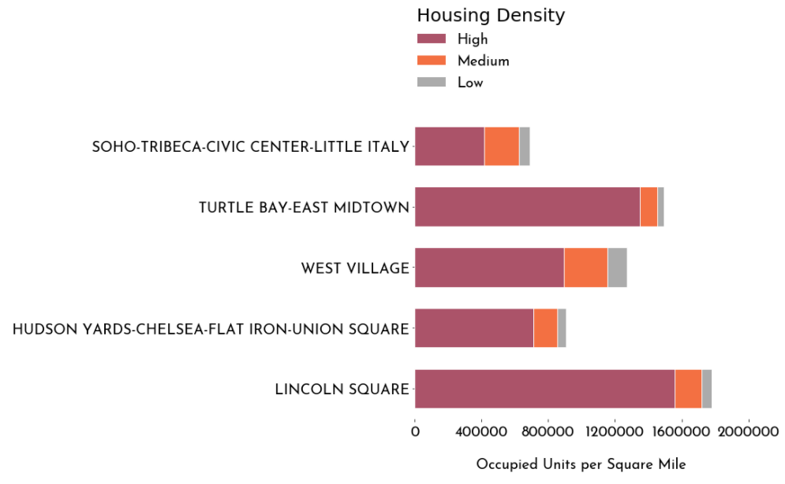
Housing Density of Target Neighborhoods
Notes:
Under the assumption that greater housing density
Means a larger potential user base,
We have visualized the housing density for each of the 5 neighborhoods.
Additionally, high density areas are less likely to be commercial neighborhoods,
Which may recover in ridership more slowly,
Due to re-opening constraints.
each bar represents occupied units per square mile, and
Each bar is then classified by housing density type.
From here, we have made the conclusion that Turtle Bay east midtown and Lincoln Square would be prime targets,
They represent some of the areas with
greatest percent decrease in ridership during the pandemic,
align with our target demographic,
and they also represent areas with greatest housing density.
High density = 20+ units
Medium density = 5-19 units
Low density = 1-4 unit, mobile home,boat,rv,van,etc
Total housing data = 2010 Total Housing of NYC
Housing type data = 2016 Census, ACS Database

Slide 12
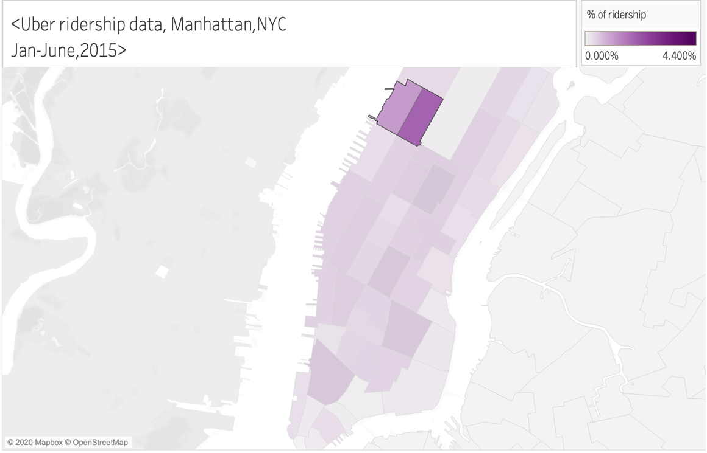
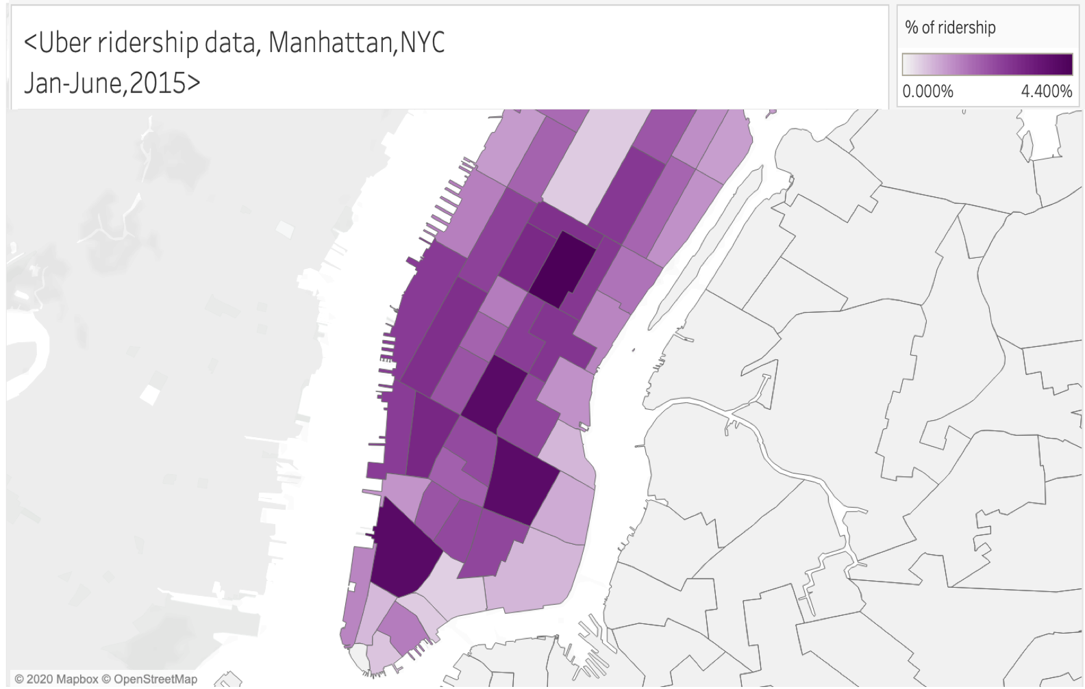
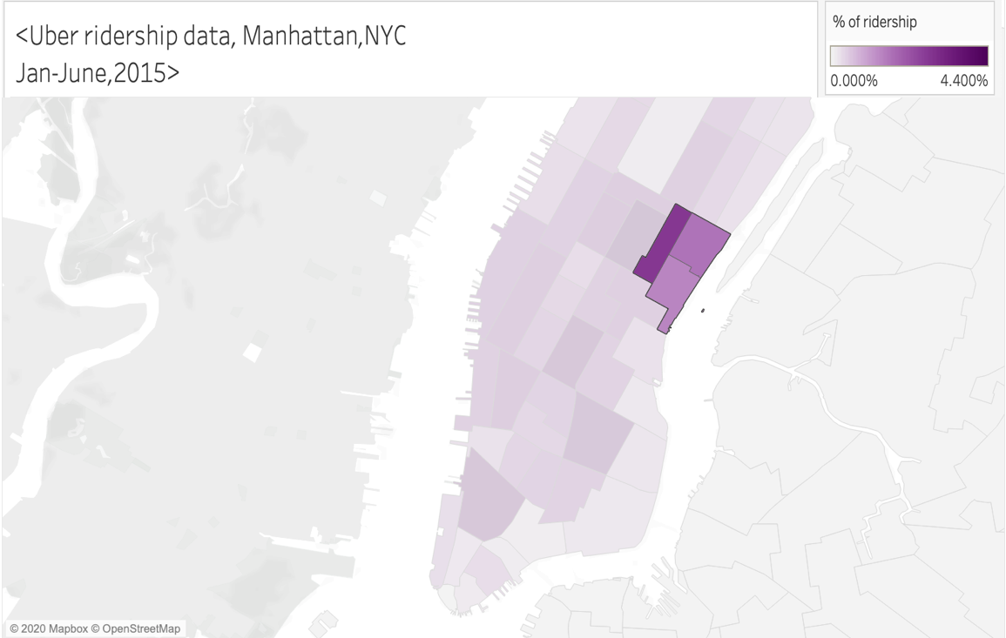
Lincoln
Square
Turtle Bay
Midtown East

Slide 13
04 Next Steps
Obtaining more recent data
Refining outlier detection/imputation
Identifying neighborhoods unlikely to recover ridership

Slide 14
Appendix

Slide 15
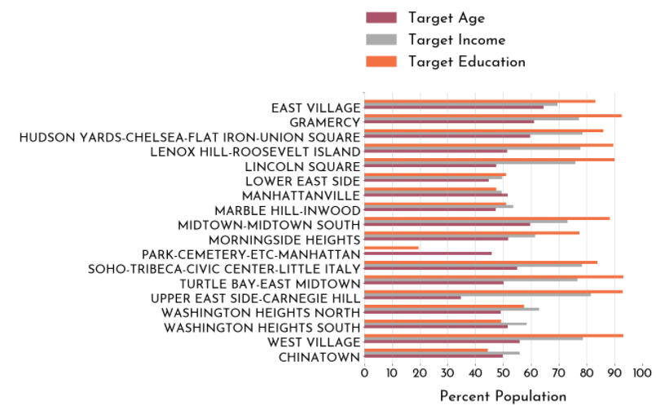
Demographic Profiles of All Neighborhoods

Slide 16
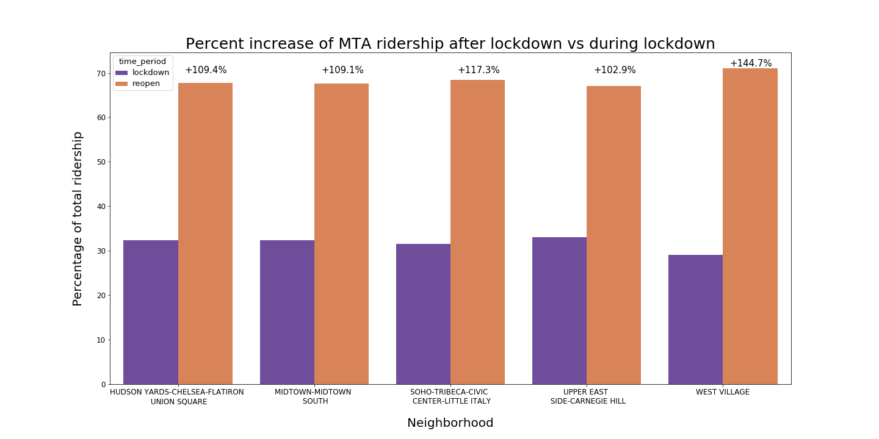

Slide 17
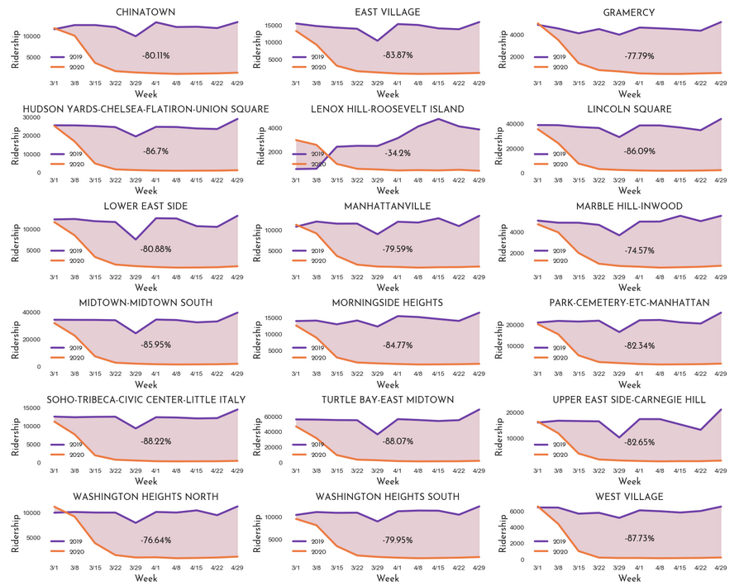
Average Daily Ridership (All Neighborhoods)
Notes:
Total housing data = 2010 Total Housing of NYC
Housing type data = 2016 Census, ACS Database

Slide 18
Credits
Data sources can be found on our project Github page.
Presentation template by Slidesgo
Icons by Flaticon
Infographics by Freepik
Images created by Freepik
Author introduction slide photo created by Freepik
Text & Image slide photo created by Freepik.com

